Slide 1
Smart Home Calendaring and Notification System
Team 2 Hojun Jaygarl, Nam Pham, Andrew Denner

Slide 2
Introduction
Overview
Brief introduction—Andrew
Description—Andrew
System Requirements—Nam
System Verification—Hojun

Slide 3
Overview of System
The Targeted user demographic: elderly and disabled persons
Users Unique Issues
Decline in cognitive function
Medical issues/Dietary needs
Medical Appointments
Other senior activities
User’s desire to remain independent

Slide 4
Overview of System (cont.)
Current existing systems
Complex and “scary”
Poorly integrated

Slide 5
Overall description
What does the Notification and Calendaring System (NCS) do?
Schedule management
Notification
Planning
Nam will go into this further next

Slide 6
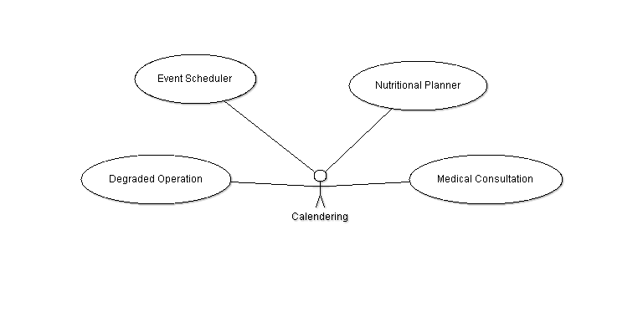
Function Diagram—Calendering Subsystem

Slide 7
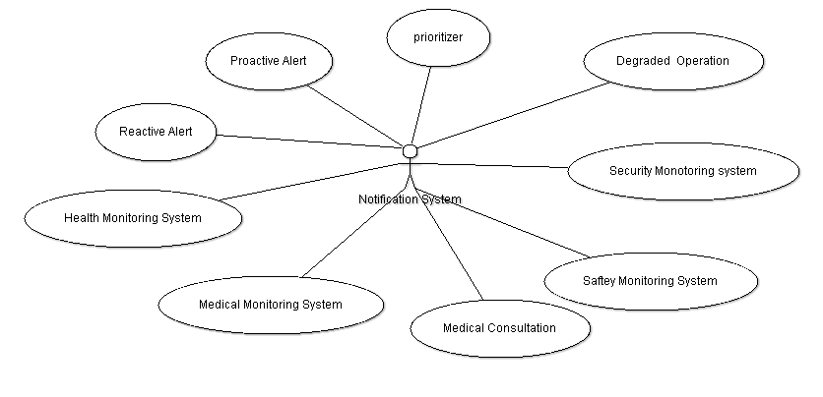
Function Diagram—Notification Subsystem

Slide 8
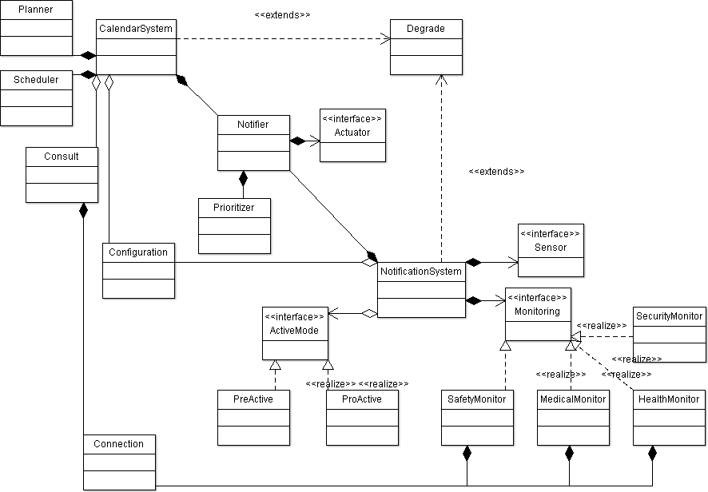
Class diagram

Slide 9
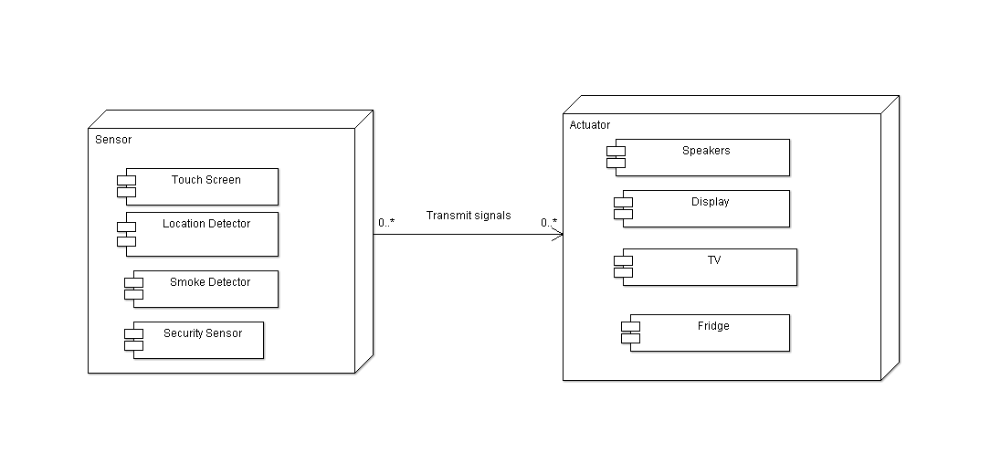
Deployment Diagram

Slide 10
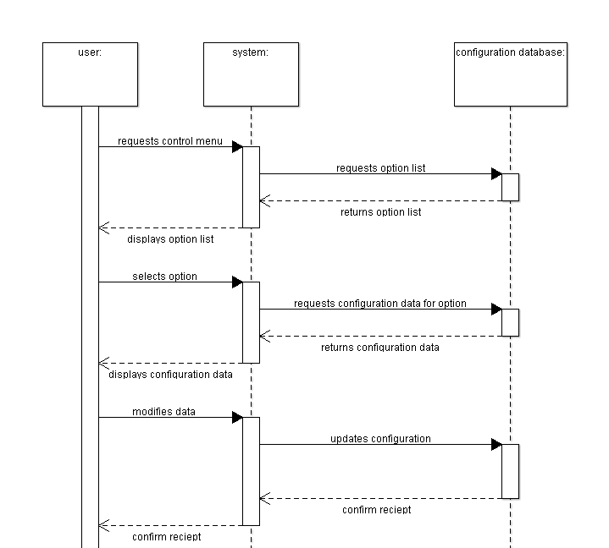
Sequence diagram for
User level control

Slide 11
System Requirements

Slide 12
Specific Requirements
Contain:
External Interface Requirements
User Interface
Hardware Interface
Software Interface
Performance Requirements
Software System Attribute
Reliability, Security, Availability, Maintainability and Reparability
Design Constraint

Slide 13
External Interface Requirements
User Interface
The primary goals of the NCS user interfaces are accessibility, universality, and reachability.
Input components | Requirements
Touch screen | Un-scratchable, finger controllable, and multi touchable
Mobile Device | small, attachable, and compatible across different devices.
Voice Recognition | accurately understand commands and, be able to handle noisy environments.
Remote controls | simple, big buttons, universal compatibility
Motion Detector | accurate, operate in low and no light conditions

Slide 14
External Interface Requirements
Output Devices | Requirements
TV | display information in a large and easy to read format
Mobile Device | display Wireless Markup Language (WML) pages as well as receive SMS text message notifications
Voice | accurately announce messages, configurable, customizable

Slide 15
External Interface Requirements
Hardware Interface
NCS has sensors to get data and actuators to provide physical services.
These sensors and actuators are connected to the home server computer through OSGi(Open Services Gate-way Initiative) interface.

Slide 16
External Interface Requirements
Sensors
Sensors | Requirements
RFID | RFID and location sensors check user's position in Smart Home environment
Motion | Motion sensor catches user's motion by detects hand motion, eye direction, etc.
Smoke, thermal, CO-detector | Smoke, thermal and CO-detector sensors detect fire.
Body sensors | Body sensors is essential to check the customer's health status

Slide 17
External Interface Requirements
Actuators:
Actuators | Requirements
Auto door | Easy and convenient for elder people
Light switch | Auto switch on/off light whether there is a person or not.
Sprinkler | Smartly detects and provides water to extinguish fire.
Auto window | Automatic open/close
Alarm(audible, visible) | the audible and visible alarm actuators

Slide 18
External Interface Requirements
Communication Interfaces
The system should be connected to the Internet or LAN.
The system shall connect with the telephone lines.
The system has a connection with an emergency protocol that is connected to a hospital, police station , and fire station.

Slide 19
External Interface Requirements
Software Interface
Subsystem of existing smart home
The Calendaring System uses iCal file format (RFC 2445)
The Notification system uses XML file format

Slide 20
PERFORMANCE REQUIREMENTS
UI Transition: The information transfers between any devices (sensors/actuators) with main system should not take more than 3s.
Data access time: The system should access any data from database in reasonable time.
Startup Time: The time between when the system is reset and normally operated should be less than 10s.
Interoperability: The system shall work smoothly with other smart home systems

Slide 21
SOFTWARE SYSTEM ATTRIBUTES
Reliability/Dependability
Security
Availability
Maintainability
Reparability

Slide 22
Reliability/Dependability
Property | Requirements
MTBF | The failure rate of two sub-system must be below 1 times/month
Fault-Tolerance | Sub-system must have a backup copy to continue operation in case the primary system fails.
Display Data Accuracy | The information displayed to users via user interface must be correct and prompt
User Setting | The information about user's preferences of system must be consistent, reliable and up-to-date
Log Accuracy | The log of everyday operation should be updated by the end of day and backed up on the weekend.
Operation Accuracy | Two subsystem must control hardware equipments like sensors and actuators precisely and safely.

Slide 23
Security
Contains three main properties:
Information congeniality
Information Integrity
Information Availability

Slide 24
Availability
The system shall provide requested service in 24/7
The response time of the system when a request arrive should be prompt and precise.

Slide 25
Maintainability
The system shall have a backup system to be upgraded parallel/online when a new device comes or some modifications taken by technician.
With very low probability, the system will introduce bugs when updating changes.

Slide 26
Reparability
The repair time shall be quick.
The system is able to be diagnosed and to replace erroneous parts while still running.

Slide 27
Design Constraints
Coding Constraint: Two sub-systems shall be developed using Java language.
Memory Constraint: The memory for all two subsystem shall not be larger than 1Gb.
Line of code constraint: The total number of LOC should be limited in range to 100k lines.

Slide 28
Design Constraints
Functionality constraint: The two sub-systems shall provide ONLY the functions required in the requirement documents
Environment constraint: The sub-systems shall be developed using the Java VM.
The interface between components shall be consistent and well described.

Slide 29
System Verification

Slide 30
Introduction of BDI
Bratman [1] proposed Belief, Desire, Intention (BDI) model based on belief, desire and intention as mental states.
BDI models of agents have been widely researched by AI researchers.
The purpose of these models is to characterize agents using anthropomorphic notions, such as mental states and actions.
formally defined using logical frameworks that allow theorists to analyze, specify and verify rational agents [6].

Slide 31
BDI Logic
BDI logic?
Belief, Desire, Intention
Logic formalism for agent planning
The Formalism
(P. Cohen and H. Levesque ‘90)
BDI model
(M. Bratman ‘87)
applied Temporal Logic.
BDI logic
(A. Rao and M. Georogeff ’91)
Much controversy exists
For a new evolvable, autonomous principle
installed Explicit Negation
improved the BDI logic
Belief and Desire with decision
(Other Philosophers)
Inference of Human Intentions
X-BDI(M. Mora et al. ’99)
AgentSpeak (Rao ‘96)
In Philosophy
In AI
(Agent Planning)
In Pervasive Computing
31

Slide 32
What is BDI[2]?
Beliefs:
represent the characteristics of the environment
are updated appropriately after each sensing action.
can be viewed as the informative component of the system.
Desires:
contain the information about the objectives to be accomplished, the priorities and payoffs associated with the various objectives
can be thought as representing the motivational state of the system.

Slide 33
What is BDI[2]?
Intentions:
represent the currently chosen course of action (the output of the most recent call to the selection function)
capture the deliberative component of the system.
BDI agents are systems:
situated in a changing environment
receive continuous perceptual input
take actions to affect their environment
based on their internal mental state.

Slide 34
Why BDI?
Best known and best studied model of practical reasoning agents.
BDI model combines a respectable philosophical model of human practical reasoning.
A number of implementations, several successful applications
the now-famous fault diagnosis system for the space shuttle, as well as factory process control systems and business process management
An elegant abstract logical semantics, which have been taken up and elaborated upon widely within the agent research community.

Slide 35
AgentSpeak(L)
Attempt to bridge the gap between theory and practice
A model that shows a one-to-one correspondence between the model theory, proof theory and the abstract interpreter.
Natural extension of logic programming for the BDI agent architecture
Based on a restricted first-order language with events and actions.
The behavior of the agent is dictated by the programs written in AgentSpeak(L).

Slide 36
Triggering event
Context
+concert (A,V) : likes(A) <- !book_tickets(A,V).
+!book_tickets(A, V) :
¬busy(phone)
<- call(V);
…;
!choose seats(A,V).
Achievement goal added
Basic action

Slide 37

About Jason[2]
a fully-fledged interpreter for AgentSpeak(L)
many extensions, providing a very expressive programming language for agents.
allows configuration of a multi-agent system to run on various hosts.
implemented in Java (thus it is multi-platform)
available Open Source and is distributed under GNU LGPL.
http://jason.sourceforge.net/

Slide 38
Safe Home Example
Beliefs
time(T)
smoke
heat
loc(outside)
loc(home)
range(on)
range(off)
smokeTime(ST)
ovenTime(ST)
mvTime(ST)
alarmTime(R,ST)
Basic Action
callenv
alarmenv
Goal
alarm
saveAlarm
callFireman

Slide 39
Safe Home Example
/* Plans */
+time(T) : smokeTime(ST) & (T > ST + 5) <- !alarm(smoke).
+time(T) : ovenTime(ST) & (T > ST + 10) <- !alarm(oven).
+time(T) : mvTime(ST) & (T > ST + 13) <- !alarm(mv).
+time(T) : alarmTime(R,ST) & (T > ST + 7) <- !callFireman(R).
//oven & MV
+oven(on) : time(T) & not ovenTime(Q) <- +ovenTime(T).
+mv(on) : time(T) & not mvTime(Q) <- +mvTime(T).
//smoke
+smoke : time(T) & not smokeTime(Q) <- +smokeTime(T).
//alarm for smoke
+!alarm(R) : loc(home) <- alarmenv; .print("ALARM!!!!! ", R); !saveAlarm(R).
+!alarm(R) : loc(outside) <- !callFireman(R).
+!alarm(R).
+!saveAlarm(R) : time(T) & not alarmTime(Q) <- +alarmTime(R,T).
//heat
+heat <- !callFireman(R).
//call
+!callFireman(R): true <- .print("call because of ", R); callenv; .send(fireman,tell,fire).

Slide 40
Rhapsody

Slide 41
What Rhapsody can do?*
A environment for Systems and Software Development
Flexible design environments supporting SysML, UML 2.0, DoDAF, and Domain Specific Languages (Rational Rose import and XMI support)
Integrated Requirements modeling, traceability and analysis
e.g., Lifecycle traceability and analysis
Small and large team collaboration
e.g., Model-based differencing and merging
Design for Testability
Model simulation
Requirements Based testing
Auto test generation
Embedded target model level debugging
Application generation
C, C++, Java, Ada
Code visualization and reverse engineering
Integration with Eclipse-based IDEs
*http://www.ilogix.com/sublevel.aspx?id=53
Notes:
DODAF: department of defense arichtecture framework

Slide 42
Model Driven Development
It starts out with making a requirements document and a series of models using UML, SysML or a similar modeling language.
These models and requirements are then used directly for the generation of code.
MDD tools use models as the primary means of development.
One of the extremely useful tools it has is its animator. It allows you to view an animated version of many diagrams in real time as the program is running.
Notes:
Excerption from Rhapsody User Guide
“Activity Diagrams show the functional flow between activities.
Statecharts (SCs) define the behavior of classifiers (actors, use cases, or classes), objects, and blocks, including the states that they can enter over their lifetime and the messages, events, or functions that cause them to transition from state to state.
Statecharts are a key animation tool used to verify the functional flow and modeling. Statecharts can be animated to view the design level of abstraction and graphically show dynamic behavior.”

Slide 43
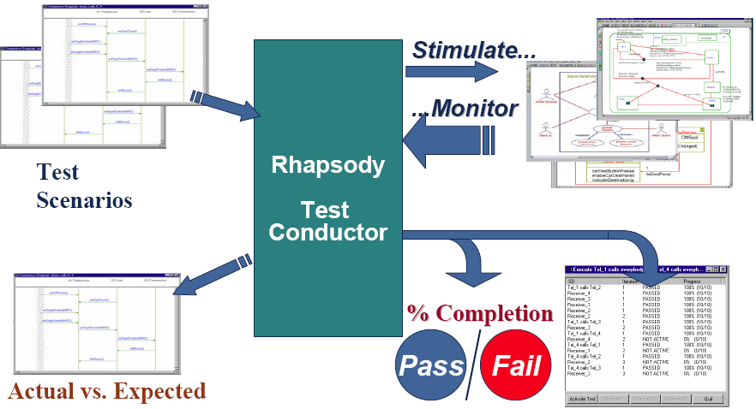
Model Based Testing

Slide 44
Use Animation to Validate the Model
Rhapsody animates the model by executing the code generated with instrumentation for classes, operations, and associations.
Animated Sequence Diagram, State Machine Diagram, and Activity Diagram help design-level debugging. E.g., step through the model, set and clear breakpoints, inject events, and generate an output trace.
Allows incremental testing
Notes:
Excerption from Rhapsody User Guide
Animation is the execution of behaviors and associated definitions in the model.
E.g. you can animate pieces of the model as it is developed

Slide 45
UML by Example: Home Alarm System
Door and movement sensors
Arm/Disarm based on 4 digit code
Code may be modified
Timeout to allow entering/exiting house
Indication lights
Siren

Slide 46
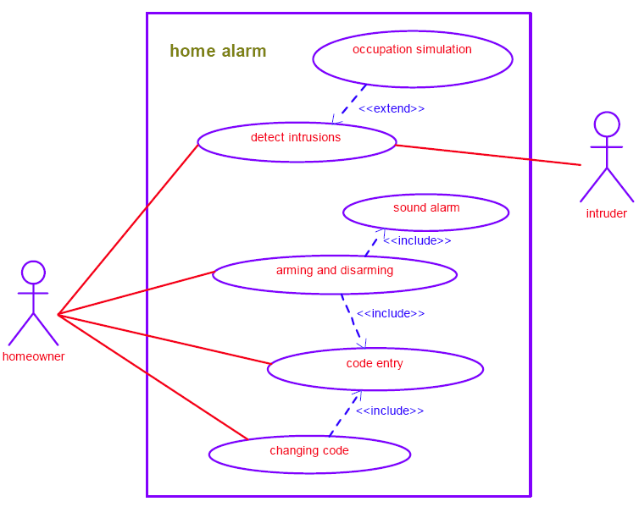
Outlining the requirements: HomeAlarm Use Cases

Slide 47
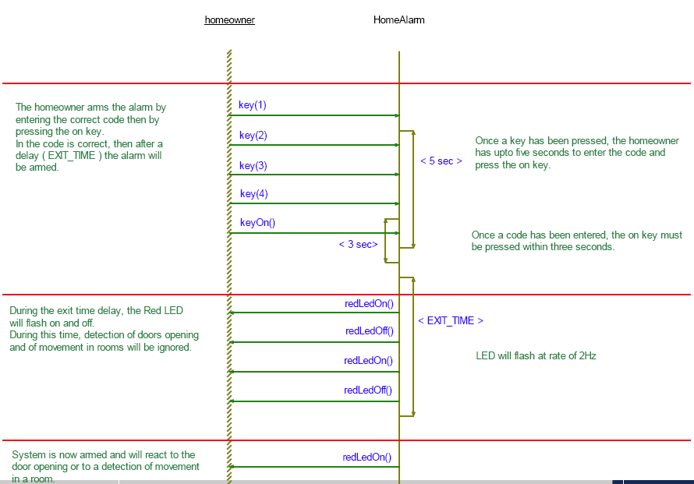
Detailed scenario: Arming the alarm
Notes:
A configuration includes the description of the classes to include in code generation, and settings for building and running the model.
Code->Generate->Debug to generate the code, make sure no errors, otherwise you have to fix it before going to the next step
Code-> Build Handset.exe to build the model
Any time you make changes to the model, you need to regenerate and rebuild the model before animating it.

Slide 48
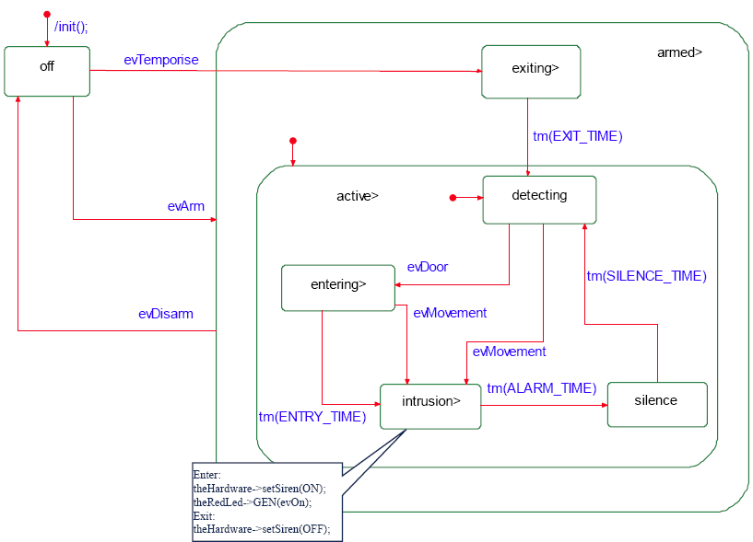
Behavior: The AlarmController
Notes:
A configuration includes the description of the classes to include in code generation, and settings for building and running the model.
Code->Generate->Debug to generate the code, make sure no errors, otherwise you have to fix it before going to the next step
Code-> Build Handset.exe to build the model
Any time you make changes to the model, you need to regenerate and rebuild the model before animating it.

Slide 49
Resource
UML resource:
http://www.uml.org/#Links-General
Model-driven Development resource:
http://www.mdsd.info/mdsd_cm/page.php?page=intro&id=5
http://www.omg.org/docs/omg/03-06-01.pdf
Rhapsody resource:
Rhapsody->Help->List of Books
http://www.ilogix.com/sublevel.aspx?id=53

Slide 50
References
M. E. Bratman, “Intentions, Plans, and Practical Reason,” Harvard University Press, Cambridge, MA, 1987.
BDI Agents and AgentSpeak(L)(Romelia Plesa,PhD Candidate, University of Ottawa)
A BDI Agent-Based Software Process(Chang-Hyun Jo, California State University Fullerton, USA, Jeffery M. Einhorn, University of North Dakota, USA.
AgentSpeak(L): BDI Agents speak out in a logical computable language (Anand S. Rao)
http://jason.sourceforge.net/mini-tutorial/getting-started/
P. R. Cohen and H. J. Levesque, “Intention is choice with commitment,” Artificial Intelligence , vol. 42, is. 2-3, pp.213-261, 1990.
Bordini, R. H., Hübner, J. F. and Vieira, R., “Jason and the Golden Fleece of agent-oriented programming.” In R. H. Bordini, M. Dastani, J. Dix, and A. El Fallah Seghrouchni, editors, Multi-Agent Programming: Languages, Platforms and Applications, chapter 1, pp. 3–37,Springer-Verlag, 2005.
Rao, A. S. “AgentSpeak(L): BDI agents speak out in a logical computable language”, In Proceedings of the 7th European Workshop on Modelling Autonomous Agents in A Multi-Agent World (MAAMAW’96,), pp. 42-55, 1996

